Slide 1
Project Title
Security Information & Event Management (SIEM)
- Rajeev Sareen

Slide 2
Problem Statement
Log management is the challenge of SIEM solutions due to the voluminous amount of data collected from different types of devices daily. Another challenge is the classification of true alerts by analysing the logs collected.

Slide 3
Objectives
To implement SIEM which will perform analysis & correlation of security events.

Slide 4
Abstract
The implementation of Security Information Event Management (SIEM) system in the IT infrastructure is the direction of the enterprise networks for monitoring malicious and anomalous traffic in Security Operation Centres (SOC). Log management is the challenge of SIEM solutions due to the voluminous amount of data collected from different types of devices daily. Another challenge is the classification of true alerts by analysing the logs collected. The Project Coordinate (Correlation of Relevant Data in Network Access Technologies) explores different correlation techniques that identify patterns based on specific components in the logs. This correlation technique can be used to aid in determining potential attacks that can happen by analysing series of logs based on header, content and behaviour. The system is tested in an isolated network environment where different attacks are executed to compare how the different correlation techniques summarize the logs.
KEYWORDS: SIEM, SOC, Correlation, Isolated Network.

Slide 5
INTRODUCTION
SIEM is a software that takes input logs and alerts from a range of systems (firewalls, routers, anti-malware, servers, etc.) and informs IT teams of unusual occurrences which warrant further investigation.
The SIEM provides real-time monitoring that significantly helps the analysts in looking and responding to network attacks.
SIEM also provides collecting and storing this raw log data, the system safeguards the data for subsequent audit needs and for compliance-aligned reporting.
Due to the variety and volume of data sent to the SIEM, different ways of summarizing the data can be used such as normalization, consolidation and correlation.

Slide 6
Critical Features of SIEM

Slide 7

#1. Log Collection
Universal Log Collection
  To collect logs from heterogeneous sources (Windows systems, Unix/Linux systems, applications, databases, routers, switches, and other devices).
Log collection method - agent-based or agentless
Centralized log collection
Events Per Second (EPS) – Rate at which your IT infrastructure sends events

Slide 8

#2. User Activity Monitoring
Ensure that the SIEM solution gives the ‘Complete audit trail’
  Know which user performed the action, what was the result of the action, on what server it happened, and user workstation/device from where the action was triggered.

Slide 9
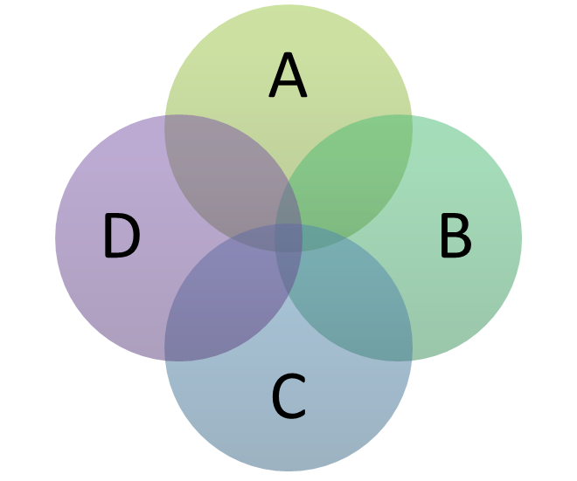
#3. Real Time Event Correlation
Real-time event correlation is all about proactively dealing with threats.
Correlation boosts network security by processing millions of events simultaneously to detect anomalous events on the network.
Correlation can be based on log search, rules and alerts
  Predefined rules and alerts are not sufficient. Custom rule and alert builder is a must for every SIEM solution.
  Ensure that the process of correlating events is easy.

Slide 10

#4. Log Retention
SIEM solutions shall automatically archive all log data from systems, devices & applications to a centralized repository.
Ease of retrieving and analyzing archived log data.

Slide 11

#5. IT Compliance Reports
IT compliance is the core of every SIEM solution.
SIEM solutions can also have the capability to customize and build new compliance reports to comply with future regulatory acts.

Slide 12

#6. Log Forensics
SIEM solutions shall allow users to track down a intruder or the event activity using log search capability.
The log search capability is user-friendly, allowing IT administrators to search through the raw log data quickly.

Slide 13
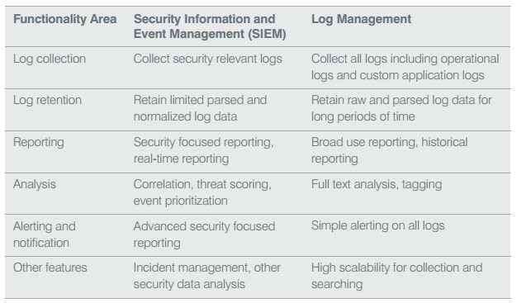
SIEM Vs. Log Management

Slide 14
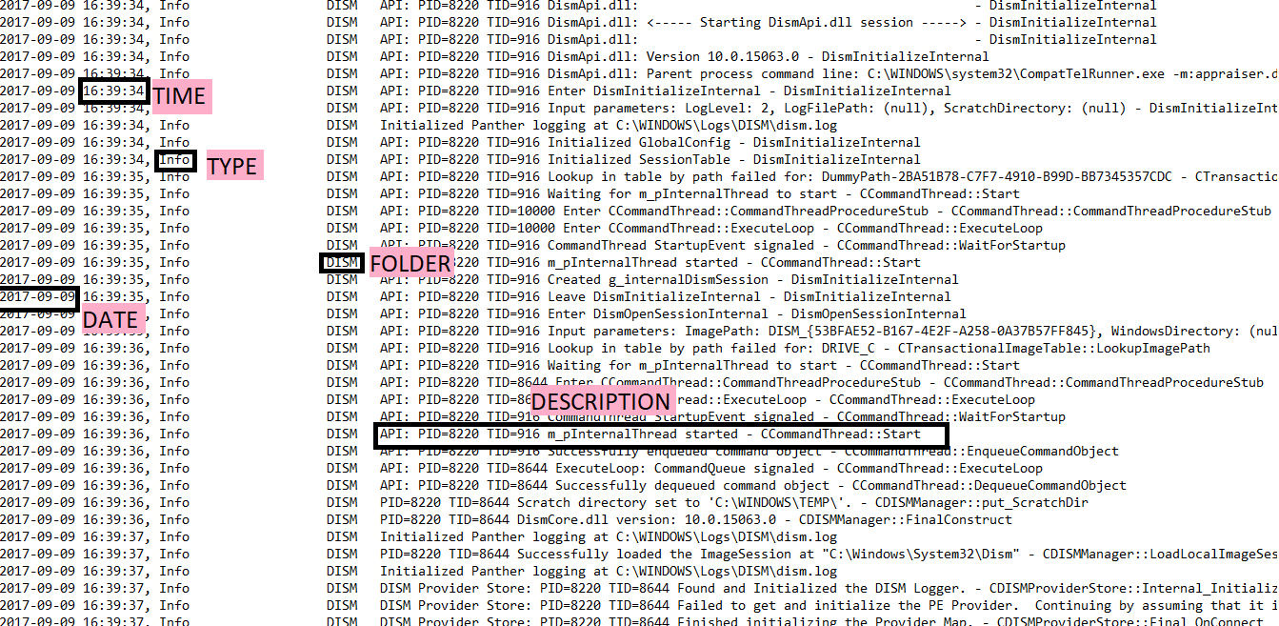
Windows LOGS SAMPLE

Slide 15
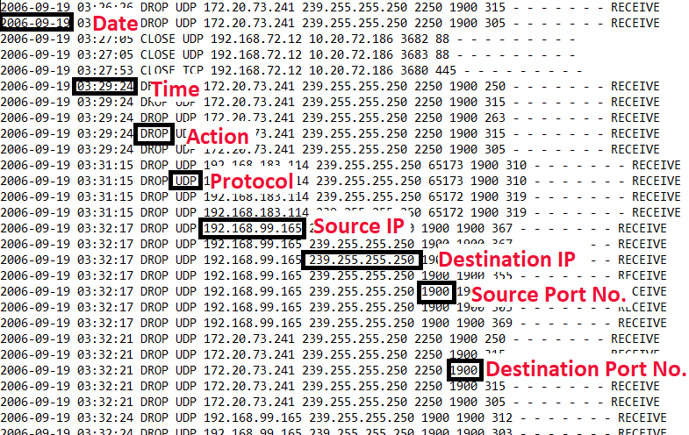
Firewall Logs Sample

Slide 16
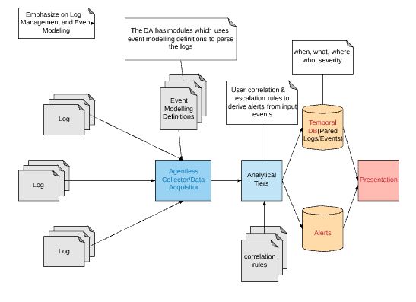
Fig 1: SIEM working

Slide 17
Flow Chart

Slide 18
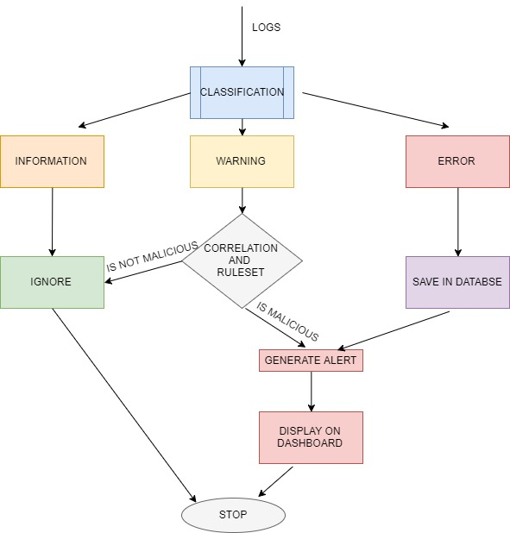
SOURCE
Fig 2: Flowchart for SIEM

Slide 19
Literature Review
Security information and event management (SIEM) software provides the log management infrastructure encompassing log analysis, log storage and log monitoring tiers. What sets SIEM products apart from traditional log management software is the ability to perform event correlation, alerting, incident management, reporting and forensic investigation based on event analysis [1].
According to Gartner description of the SIEM [2], SIEM technology aggregates the event data produced by security devices, network devices, systems and applications. The primary data source is log data, but SIEM technology can also process other forms of data. The data is normalized, so that events from disparate sources can be correlated and analyzed for specific purposes.
Saleh, Macia-Fernandez and Diaz-Verdejo list 3 major groups of correlation methods that are used by modern security systems, including SIEM. The three main groups are Similarity based, Sequential based and Case based [3].

Slide 20
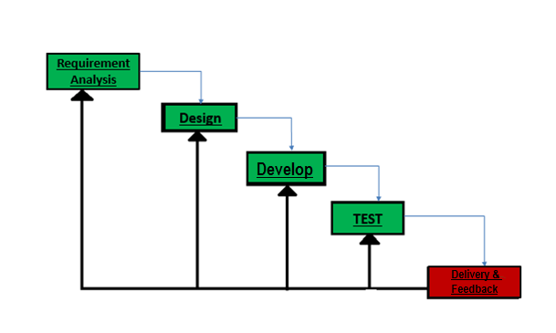
Methodology
Fig 3: Iterative Waterfall Model

Slide 21
Methodology
Iterations will take place during the iterative waterfall development lifecycle. A typical iteration process flow can be visualized as follows:
Requirements - All possible requirements of the project to be developed were captured in this phase and documented in a requirement specification document.
Designing - The requirement specifications from first phase were studied in this phase and system design was prepared. System design helps in defining overall system architecture.
Development - The logs were captured; a small unit of program was then developed. Each unit was developed and tested for its functionality which is referred to as unit testing.
Testing - QA (Quality Assurance) testing was performed on the unit developed in the development phase & was integrated into a system after testing.
Delivery – The working iteration was integrated into production & then deliver.
Feedback – Will accept user feedback and work it into the requirements of the next iteration.

Slide 22
System Requirements
Software:
Programming Language: Python
Interpreter: Idle
Operating System: Windows 8 and above
Hardware:
Computer with minimum 512MB RAM, 128GB Hard Drive

Slide 23
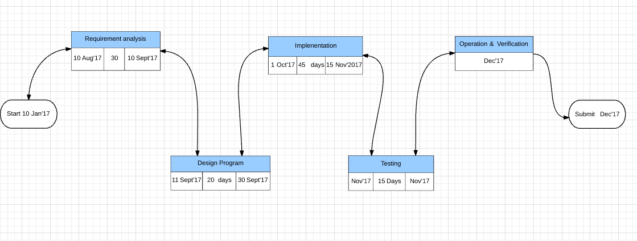
Pert Chart

Slide 24
Basic Rule Set for SIEM
Warn if 4 or more failed login attempts are made from the same IP address.
Warn if multiple requests are made from the same IP address to some destination IP address. (DOS)
Warn if multiple requests are made from different IP address to same destination IP address. (DDOS)
Warn if a process is creating multiple warning logs entries simultaneously in the log file.
Generate an alert if any error occurs.

Slide 25
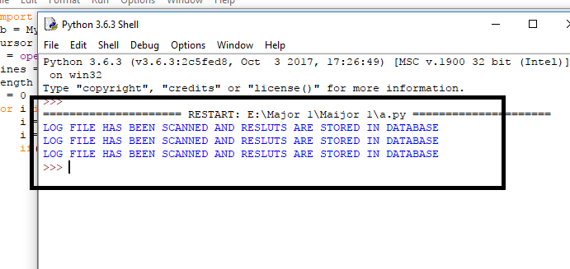
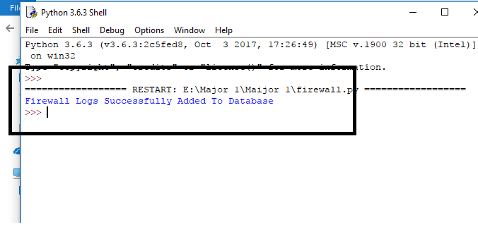
Outputs

Slide 26
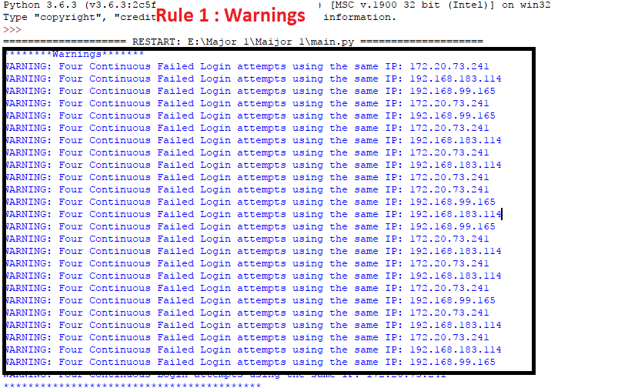
Result

Slide 27
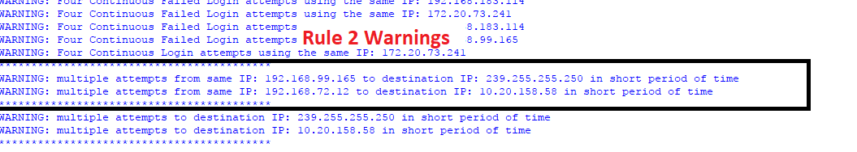
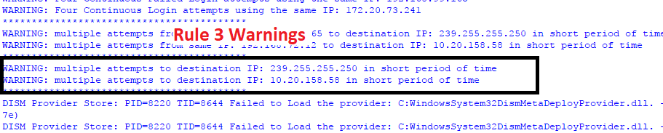

Slide 28
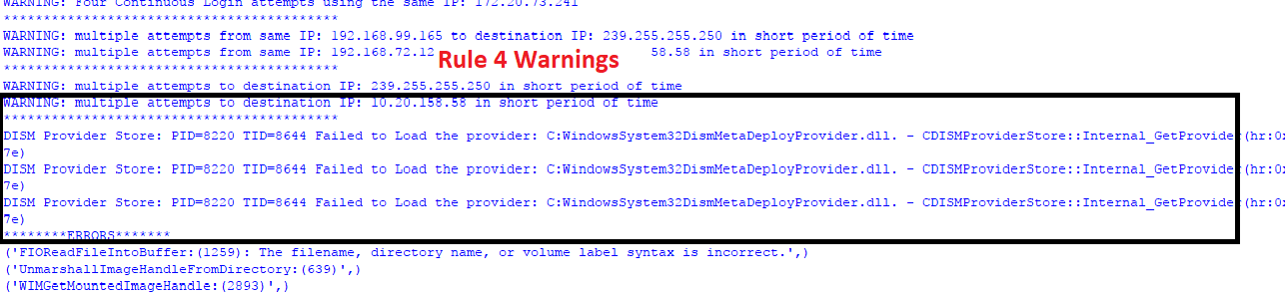

Slide 29
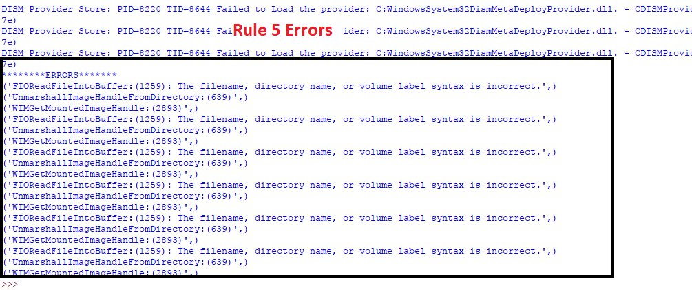

Slide 30
Conclusion & Future Scope
  Conclusion
Towards the end of the project, developers were successfully able to implement the Security Information and Event Management. Developers learned new concepts related to python language, python database connectivity & different type of logs, correlation techniques and their criticality in the window’s environment. Because of the limited knowledge and time constraints, developers were only able to build a prototype of the SIEM.
  Future Scope
High level correlation rules can be developed and implemented according to the similar results obtained by the present SIEM rules.
Other correlation rules can be added according to the need of the organization.
The classified results can be shown graphically by implementing GUI.
Artificial Intelligence and machine learning algorithms can be used to further analyze the results to produce a more optimized output.

Slide 31
References
[1] SANS Institute-InfoSec Reading Room (2012). Logging and Monitoring to Detect Network Intrusions and Compliance Violations in the Environment. [online] pp.2-6
[2] Gartner. (2015). Critical Capabilities for Security Information and Event Management (pp. 13-17).
[3] Salah, S., Macia-Fernandez, G., & J Diaz-Verdejo, J. E. (2013). A model-based Survey of Alert Correlation Techniques. Computer Networks, 1289-1317.

Slide 32
THANK YOU

